Slide 1

By Ben Livingston

Slide 2
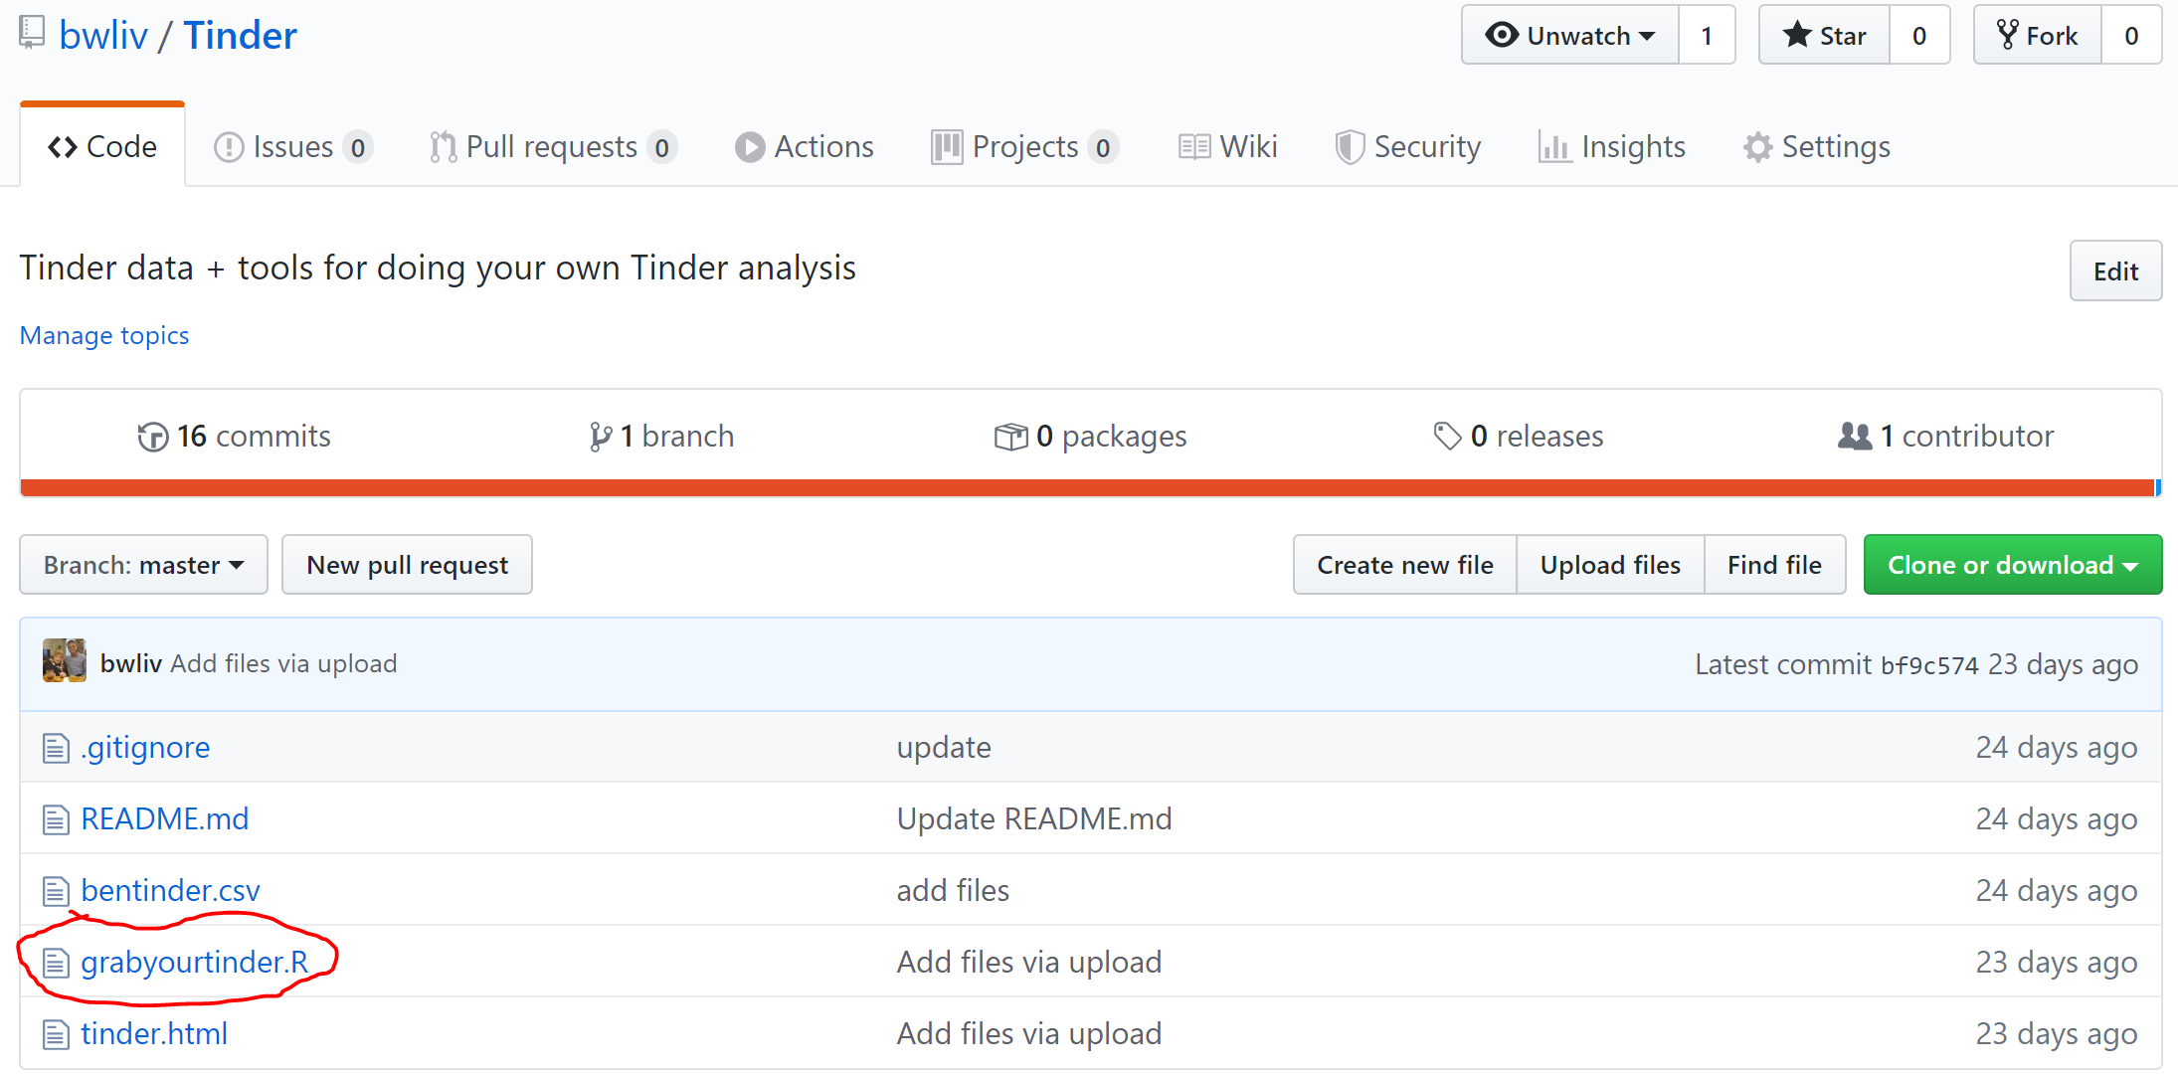
Do this yourself!
github.com/bwliv/Tinder

Slide 3
All-Time Stats (2014-2019)
App Opens | 25,081
Messages (Sent + Received) | 42,203
Matches | 8,777
Likes | 75,404
Passes | 214,505
Swipe Right Rate | 26.0%
Swipes | 289,909

Slide 4
Wait a second…
Swipes | 289,909

Slide 5
Wait a second…
Swipes | 289,909
Swipes in Pennsylvania | 273,682

Slide 6
Wait a second…
Swipes | 289,909
Swipes in Pennsylvania | 273,682
Estimated LGBT Population of Pennsylvania | 230,453

Slide 7
Wait a second…
Swipes | 289,909
Swipes in Pennsylvania | 273,682
Estimated LGBT Population of Pennsylvania | 230,453
LGBT Men in PA? | 115,000

Slide 8

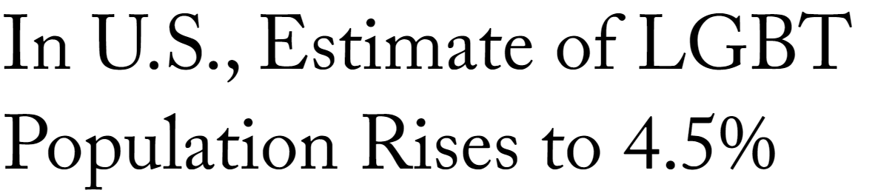

Slide 9
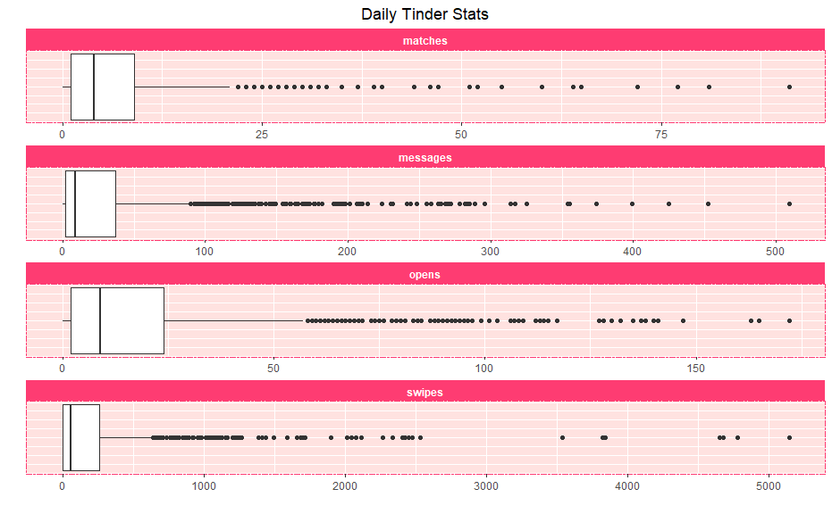
So Many Outliers!

Slide 10
Daily Records
App Opens | 172
Swipes | 5,144
Matches | 91
Messages (Sent + Received) | 509

Slide 11
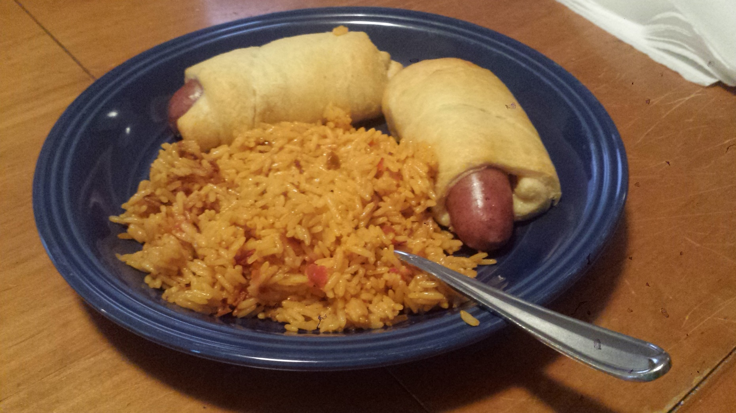
What 5,144 Swipes Looks Like

Slide 12

What 509 Messages Looks Like

Slide 13
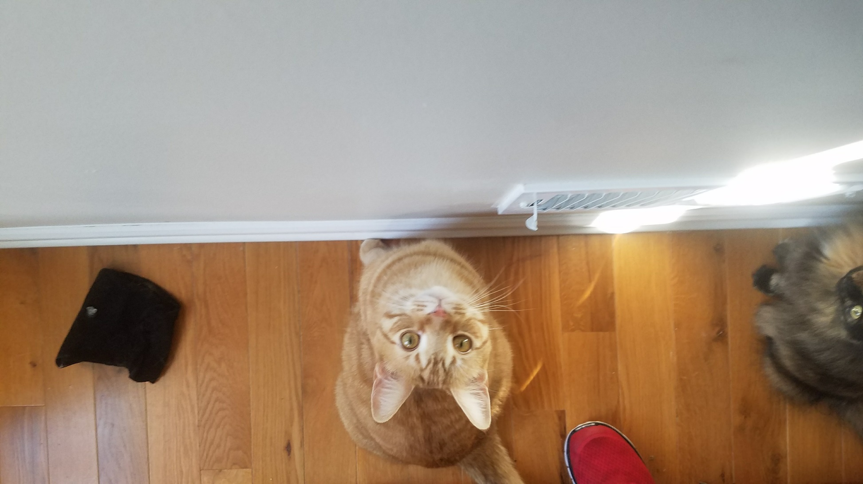
What 172 Tinder Opens Looks Like

Slide 14
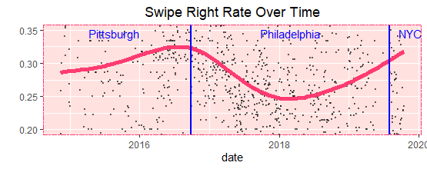
This Data Must Be Wrong!

Slide 15

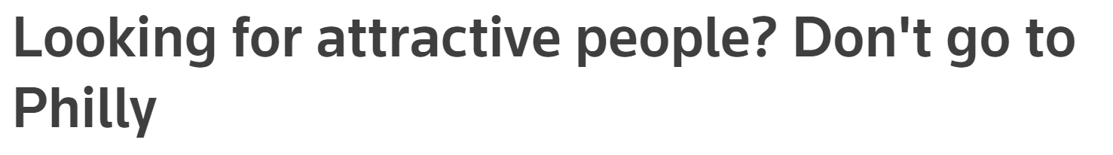
Okay, Maybe Not…

Slide 16
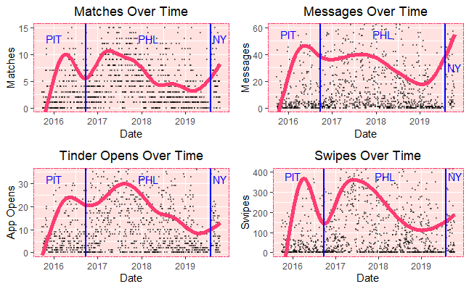
In Conclusion…
…move to New York?

Slide 17
Your turn!
github.com/bwliv/Tinder

